Slide 1

asCrowdsensed Approach
A Crowdsourced Mobile Network Monitoring System
Course
Type
Software Requirements Analysis and Specification
University Software Engineering Project
Platform
Android-First Crowdsourced Intelligence

Slide 2

Introduction & Problem Statement
Poor Coverage Experience
Weak mobile network coverage degrades user experience across urban and rural areas.
Lack of Crowdsourced Intelligence
No accessible platform aggregates real-world network quality data from users.
Limited Existing Solutions
Current tools are proprietary, expensive, or lack geographical granularity.
Need for Geo-Analytics
Telecom operators require real-world, location-tagged network performance insights.

Slide 3

Project Aim & Objectives
Develop a crowdsourced mobile network monitoring system that empowers users and operators alike.
Automatic Signal Monitoring
GPS-Based Coverage Mapping
Offline-First Sync
Continuously collect network quality metrics in the background.
Tag every data point with precise geographic coordinates.
Collect data without connectivity and synchronize when online.
Analytics Dashboard
User Issue Reporting
Provide operators with heatmaps and performance insights.
Allow users to manually flag network problems with location context.

Slide 4
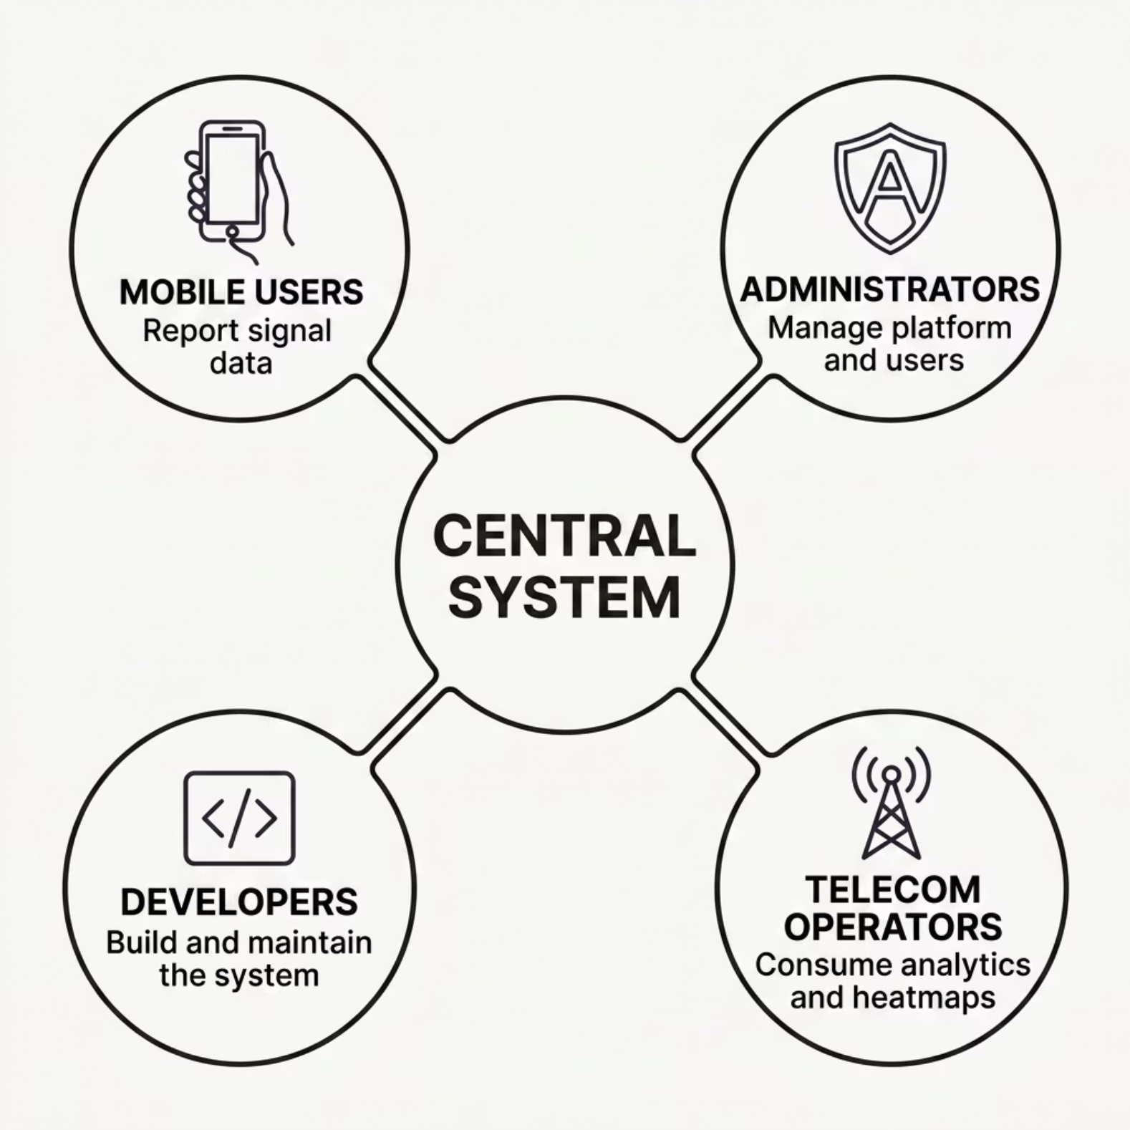

Requirement Gathering & Stakeholders
Gathering Methods
Stakeholder analysis
User observations
System research
Telecom problem analysis

Slide 5

Requirements Analysis
Android Feasibility
Completeness
All scenarios and edge cases covered
Clarity
Kotlin + Jetpack Compose confirmed viable for background monitoring.
Unambiguous, testable specifications
Requirements Analysis
Validate definitions, feasibility, and consistency
Offline-First
Local storage with deferred sync is architecturally sound.
Technical Feasibility
Android, offline-first, PostGIS viability
Dependency Analysis
Map inter-requirement relationships
PostGIS Scalability
PostgreSQL with PostGIS supports large-scale geospatial queries.
Each phase validates that requirements are well-defined, technically achievable, and internally consistent.

Slide 6
Functional & Non-Functional Requirements
Functional
Non-Functional
🔒 Security
⚡ Battery Optimization
Encrypted data transmission and secure auth.
Signal Monitoring
GPS Tracking
Minimal drain via efficient background scheduling.
📈 Scalability
✅ Reliability & Availability
Heatmap Generation
Synchronization
Handles growing user base and data volume.
High uptime with resilient offline fallback.
User Reporting

Slide 7
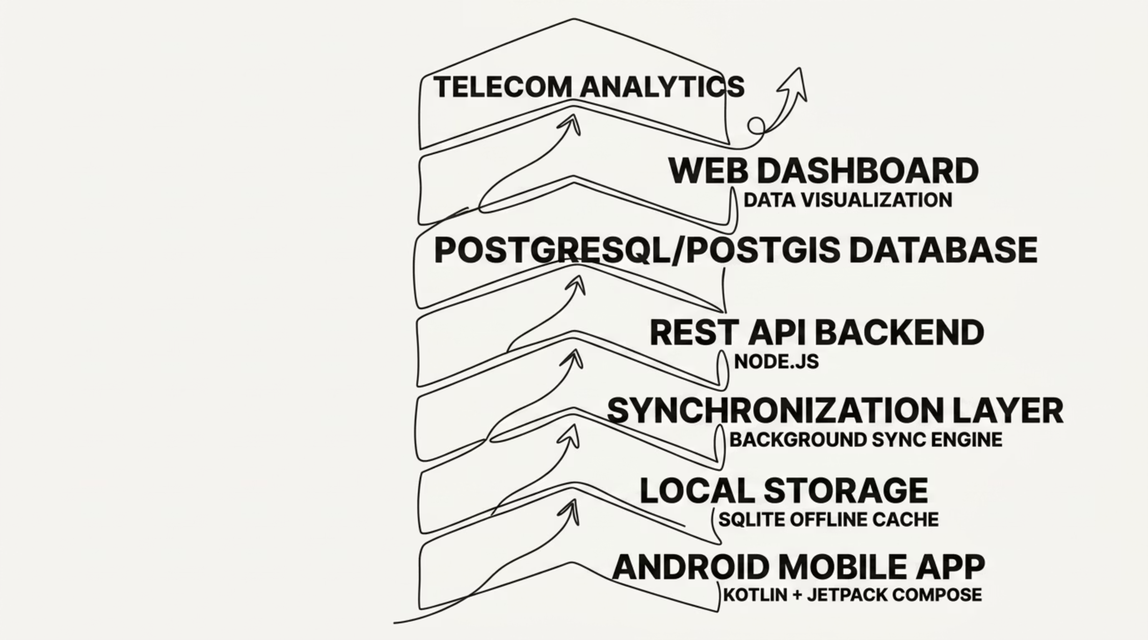

System Architecture
An offline-first, cloud-backed architecture ensures continuous data collection, reliable synchronization, and powerful geospatial analytics for telecom operators.

Slide 8
System Features & Workflow
Data Collection
1
Automatic background signal monitoring with GPS tagging.
Local Storage
2
Offline-first caching ensures no data loss without connectivity.
Synchronization
3
Background sync uploads batched records when online.
Backend Processing
4
Node.js API processes and stores data in PostGIS.
Visualization
5
Coverage heatmaps and analytics rendered on the web dashboard.

Slide 9

Challenges, Constraints & Validation
Key Challenges
Android Background Restrictions
OS limits on background processes require careful scheduling.
Validation Approach
Battery Optimization
Balancing continuous monitoring with minimal power consumption.
Unstable Connectivity
Sync must be robust against intermittent internet access.
Stakeholder Review
Requirement Refinement
Technical Feasibility
GPS Permissions
Handling runtime location permissions gracefully on Android.

Slide 10

Conclusion & Future Improvements
What We Achieved
Future Roadmap
Requirements successfully analyzed and documented
🤖 AI Anomaly Detection
Scalable offline-first architecture proposed
📊 Predictive Analytics
Reliable telecom analytics platform designed
🔔 Real-Time Alerts
🍎 iOS Support
Thank You

